Slide 1
Numerical Simulation of Seismic Waves and Mitigating the Effects by Seismic Barriers
Umut Polat
MSc. Mechanics and Mathematical Modeling
Higher School of Theoretical Mechanics
Peter the Great St. Petersburg Polytechnic University
Scientific advisor: E. A. Podolskaya, Associate Professor at SPbPU, PhD.
Work advisor: V. A. Bratov, Scientific researcher at SPbPU, PhD.

Slide 2
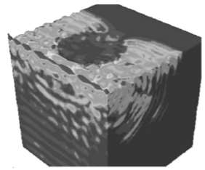
2. Problem Statement
This study focuses on seismic protection of structures from the hazardous effects of surface waves by implementing vertical seismic barrier.
The goal of this research is to determine optimal seismic barrier properties and dimensions that provide the most effective protective zone behind the seismic barrier.
Figure 2. Vertical seismic barrier implementation by circulating the construction 360 degrees [Kuznetsov, S. V. (2011). Seismic waves and seismic barriers. Acoustical Physics, 57(3), 420-426.]

Slide 3
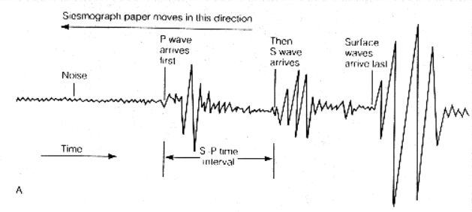
3. Types of Seismic Waves
During an earthquake, four main seismic wave types can be observed with the help of a seismograph: body waves such as longitudinal (P-wave) and transversal (S-wave) waves and surface waves, which are observed after the body waves in the seismograph; Rayleigh and Love waves.
Figure 3. Seismograph recording illustration according to their arrival times [https://darkwing.uoregon.edu/~drt/Classes/201_99/Rice/Seismology.html]
Love waves propagate on the interface between the elastic half-plane and contacting layer as long as the following condition is satisfied: The bulk wave speed of the elastic layer are greater than of the speed of bulk waves in half-space. ( ) where C* represents speed of transversal bulk waves.

Slide 4
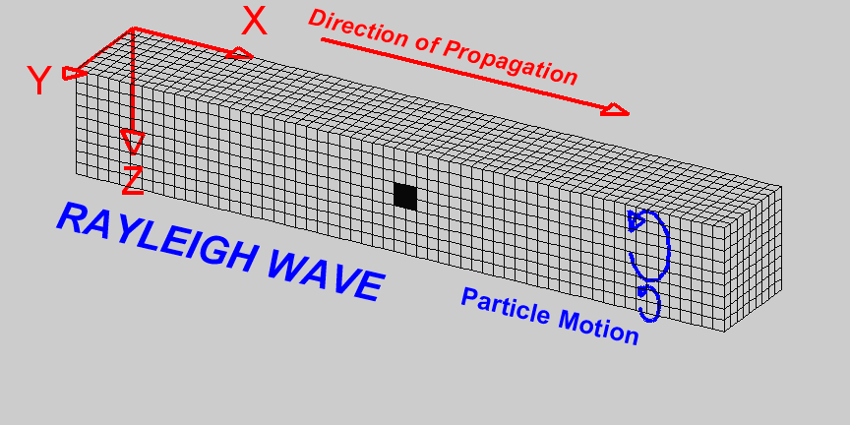
4. Rayleigh Wave
Figure 6. Animation of Rayleigh wave
[https://web.ics.purdue.edu/~braile/edumod/waves/WaveDemo.htm]

Slide 5
5. Mathematical Expression of the Rayleigh Wave Propagation
Assuming the wave propagation medium is isotropic homogenous media, equation of motion can be described by Navier-Clapeyron theorem [François, D., Pineau, A., & Zaoui, A. (1998). Mechanical behaviour of materials]:
(4)
Since the medium is isotropic, Lame constants (λ and μ) can be utilized to calculate Longitudinal (5) and Transversal wave speed (6). ρ is denoted as the material density (kg/m³).
(5)
(6)
Equation (4) can be rewritten considering P and S waves. Substituting equation (5) and (6) into equation (4), equation of motion in terms of P and S waves can be obtained.
(7)
For plane strain problem body forces can be ignored and the displacement vector u can be decomposed into vector and scalar potentials by Helmoltz decomposition theorem [Morino, L. (1986). Helmholtz decomposition revisited: vorticity generation and trailing edge condition. Computational Mechanics, 1(1), 65-90]
(8)
In which Φ is scalar potential. And vector potential s satisfies .

Slide 6
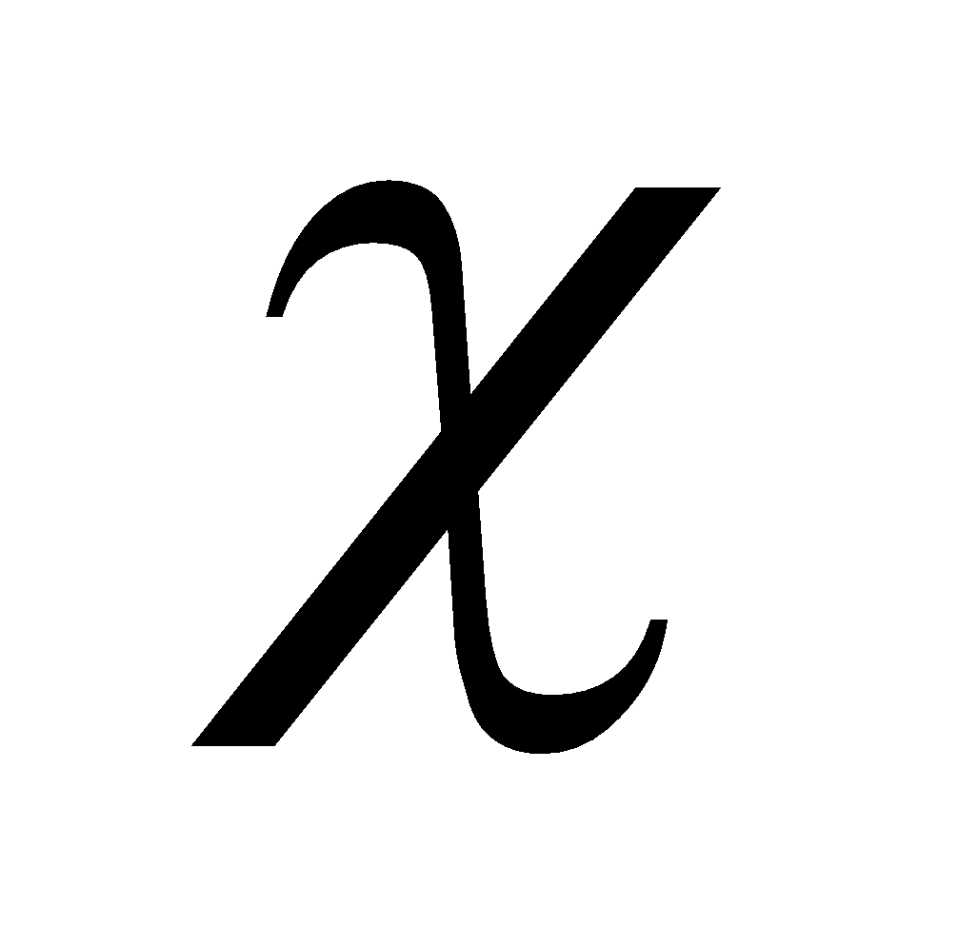
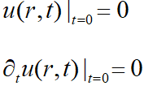
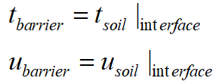
The displacement field in x and y direction is shown in equations (9) and (10) respectively.
(9)
(10)
where 𝜙 and s are scalar and vector wave potentials for longitudinal and transversal waves.
Boundary condition:
On the boundary surface of a half plane Ώ , (considering the isotropic media) it is assumed that there are no tractions. Therefore, equation (11) can be used as a boundary condition.
(11)
Assuming no tractions on the surface: where is the unit normal to the surface, I is the unit diagonal matrix and u is the displacement vector.
Initial Condition
Since there are no initial stresses in the half plane, initial conditions were taken as stated below:
(12)
(13)
At the interface between soil and seismic barrier ideal mechanical contact was used.
(14)
(15)

Slide 7
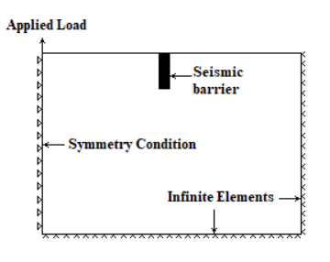
5. Numerical Simulation
An elastic half-space (110 x 75m) model with plane strain elements was designed using ABAQUS.
At the bottom and the right side of the plane, infinite elements (the element type “CINPE4”) were utilized to avert reflections from the boundaries which can affect the solution. Explicit Dynamic analysis method was utilized to simulate the wave propagation.
The sinusoidal excitation (displacement) was given from the top left corner where the symmetry condition applied according to function, where A is maximum amplitude, f is frequency and t is cumulative time.
Reduction factor (K) and protection percentage (P) was calculated according to the equations below to see the effectiveness of the barriers.
(16)
(17)
Figure 7. Numerical model and boundary conditions in ABAQUS
Figure 8. Dimensions of seismic barriers

Slide 8
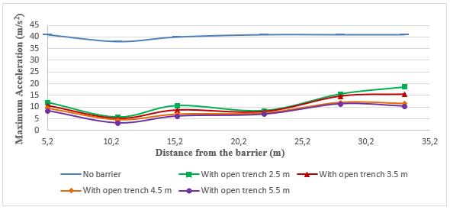
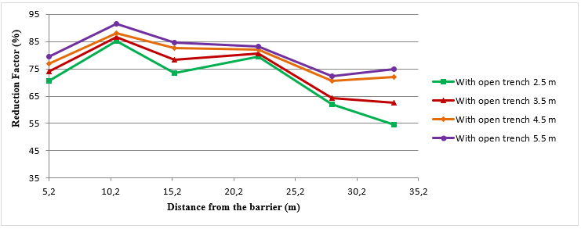
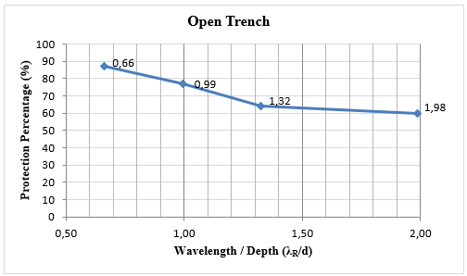
6. Numerical Simulation Results
6.1. Simulation Results for Open Trench
Figure 9. Maximum acceleration rates after implementing empty trench
Figure 10. Reduction factors after implementing an empty trench
Figure 11. Protection percentages for open trenches with respect to the wavelength-depth ratio for fixed barrier depth (4.5 m)
As it can be monitored from the figure 10, after 10 meters reduction factor was reduced and Rayleigh waves overflew the empty trench. Thus, the statement of S. Kuznetsov [Kuznetsov, S. V. (2011). Seismic waves and seismic barriers. Acoustical Physics, 57(3), 420-426.] “However, propagating Rayleigh or Love waves will simply overflow an empty trench.” is confirmed.

Slide 9
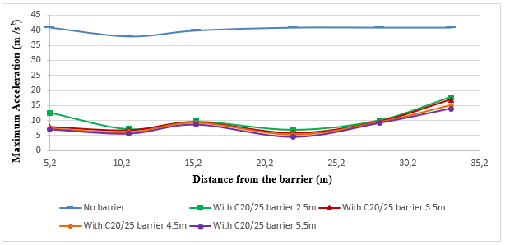
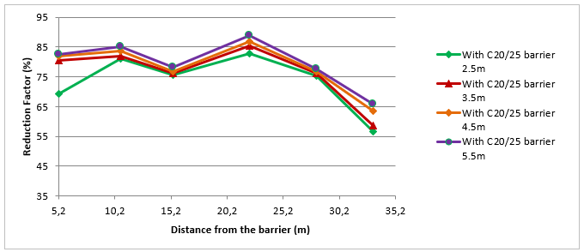
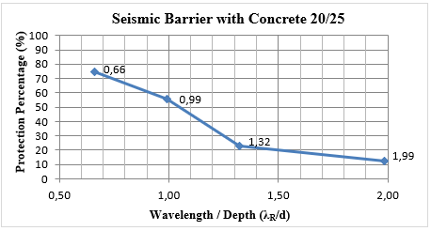
6.2. Results for Seismic Barrier with Concrete 20/25
Figure 12. Maximum acceleration rates after placing barrier with Concrete 20/25
Figure 13. Reduction factors in the acceleration after placing seismic barrier with Concrete 20/25
Figure 14. Protection percentages for a seismic barrier with Concrete 20/25 with respect to the wavelength-depth ratio for fixed barrier depth (4.5 m)
As can be observed from figure 13, after 22 meters away from the barrier, the acceleration increased steadily. Therefore, the effective protection zone was remarked as 22 meters.

Slide 10
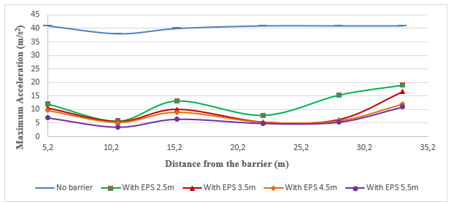
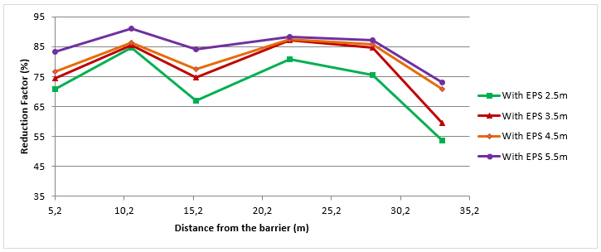
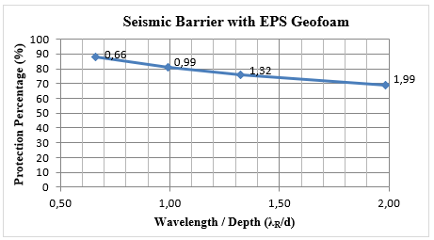
6.3. Results for Seismic Barrier with Eps (Expanded Polystyrene) Geofoam
Figure 15. Maximum acceleration rates after placing barrier with Eps Geofoam
Figure 16. Reduction factors in the acceleration after placing seismic barrier with Eps Geofoam
Figure 17. Protection percentages for a seismic barrier with Eps Geofoam with respect to the wavelength-depth ratio for fixed barrier depth (4.5 m)
For wavelengths bigger than the seismic barrier depth (4.5 meters), the protection percentage diminished below 80 %. Thus, it can be deducted that even for smaller depths of barriers with Eps can provide adequate protection nearly 70 %.

Slide 11
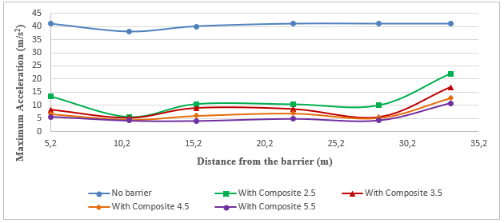
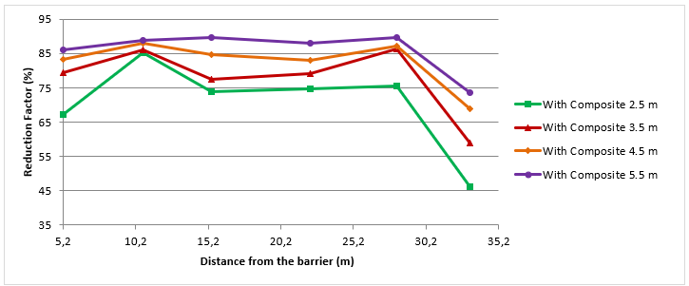
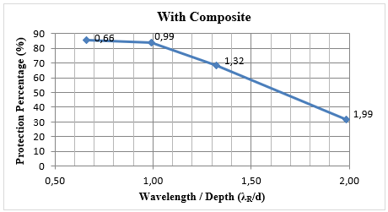
6.4. Results for Seismic Barrier with Composite Material
Figure 18. Maximum acceleration rates after placing barrier with Composite material
Figure 19. Reduction factors in the acceleration after placing seismic barrier with Composite material (Eps and Concrete 20/25)
Figure 20. Protection percentages for a seismic barrier with Composite material with respect to the wavelength-depth ratio for fixed barrier depth (4.5 m)
It can be clearly visible that for wavelengths bigger than the barrier depth (4.5 meters), the protection percentage linearly fell to 30 %. Therefore, the depth of the seismic barrier should be chosen bigger than the wavelength of the surface waves.

Slide 12
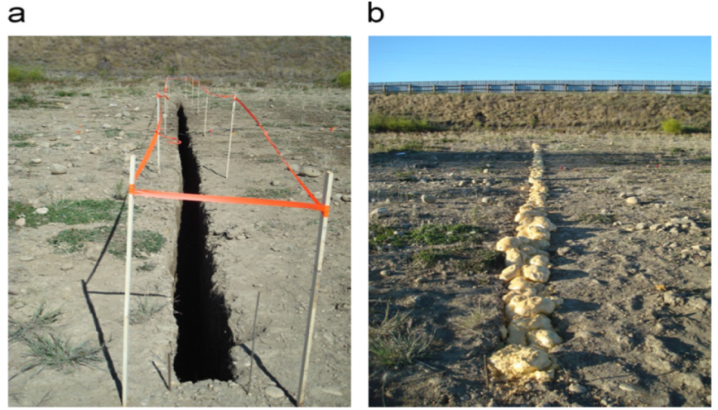
6.5. Comparison of Simulation Results with Experimental Findings
To validate the model of the numerical simulation, experimental findings of the study which was conducted by A. Alzawi et al. [Alzawi, A., & El Naggar, M. H. (2011). Full scale experimental study on vibration scattering using open and in-filled (GeoFoam) wave barriers. Soil Dynamics and Earthquake Engineering, 31(3), 306-317] were taken for comparison.
In the experimental study, an open trench (a) and with 3 meters-depth, 0.25 m-width Eps GeoFoam barrier (b) was utilized. As a load, a harmonic sinusoidal force of 23.5 kN was applied to the ground with the frequencies of 40 Hz, 50 Hz and 58.84 Hz.
Figure 21. Trench barriers: (a) open trench (b) Eps Geofoam trench [Alzawi, A., & El Naggar, M. H. (2011). Full scale experimental study on vibration scattering using open and in-filled (GeoFoam) wave barriers. Soil Dynamics and Earthquake Engineering, 31(3), 306-317]

Slide 13
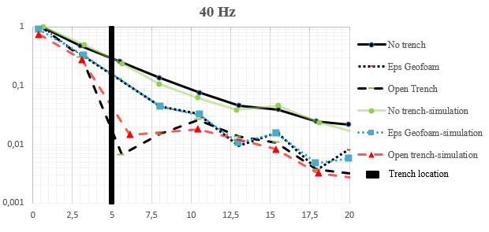
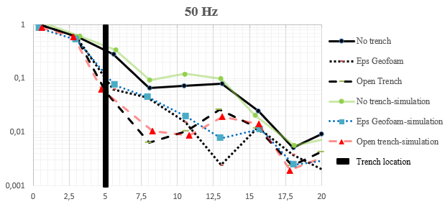
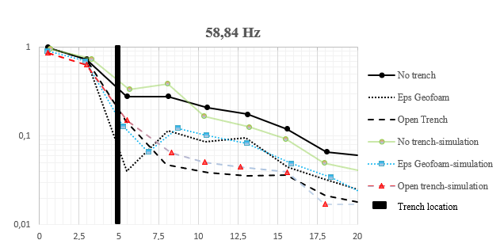
Figure 22. Comparison of Experimental data and numerical simulation results for 40 Hz load
Figure 23. Comparison of Experimental data and numerical simulation results for 50 Hz load
Figure 24. Comparison of Experimental data and numerical simulation results for 50 Hz load
Comparing the graphs of field experiment and the simulation results, it can be deducted that results of the numerical simulation and experimental results followed a similar pattern. Due to the reflections from the boundaries and the inhomogeneities in the soil, variations in the vertical soil particle velocities were observed in experimental results.
Thanks to the similarities between the numerical simulation results and the experimental results, the numerical simulation model can be assumed as validated.

Slide 14
Conclusion
Increasing the barrier depth proved to be helpful for the sake of vibration isolation for all the seismic barriers types.
Empty trench provided substantial protection effectiveness, but Rayleigh waves simply overflew the seismic barrier and continued its propagation after encountering with the barrier.
Composite material, which is composed of Geofoam and Concrete 20/25, is found out to be the most effective material of barrier since it provided the longest protection zone (28 meters).
Dimensions of the seismic barriers should be chosen bigger than the Rayleigh wave to obtain a effective protection from surface waves.

Slide 15
Thank you for your attention.

