Slide 1
THERMO-MECHANICAL MODEL TO STUDY MICROSTRUCTURE DURING ADDITIVE MANUFACTURING
Nikhil Mohanan
MSc. Mechanics and Mathematical Modeling
Higher School of Theoretical Mechanics
Peter the Great St. Petersburg Polytechnic University
Internal Supervisor: Prof. Vitaly A Kuzkin
Higher School of Theoretical Mechanics
Peter the Great St. Petersburg Polytechnic University, Russia
External Supervisor: Prof. Manas V Upadhyay
Laboratoire de Mecanique des Solides
Ecole Polytechnique, Paris, France

Slide 2
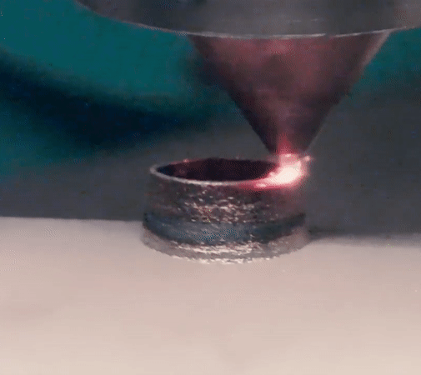
Motivation : What happens to a microstructure during AM?
$$\left(a\right)$$
$$\left(b\right)$$
BeAM Additive Manufacturing, LMS
Source: Manas V Upadhyay, 2020 (hal-02439503v3)

Slide 3
Aim, Objectives and Methodology
Aim :
Study microstructure evolution due to SSTC during AM
Objectives :
Create a finite element micromechanical solver to study SSTC on the microstructure during AM:
To account for the effects of fully coupled Thermo-Elastodynamics
To account for heterogeneous material behavior
Methodology :
Divide and Conquer Methodology - Model individual components and combine

Slide 4
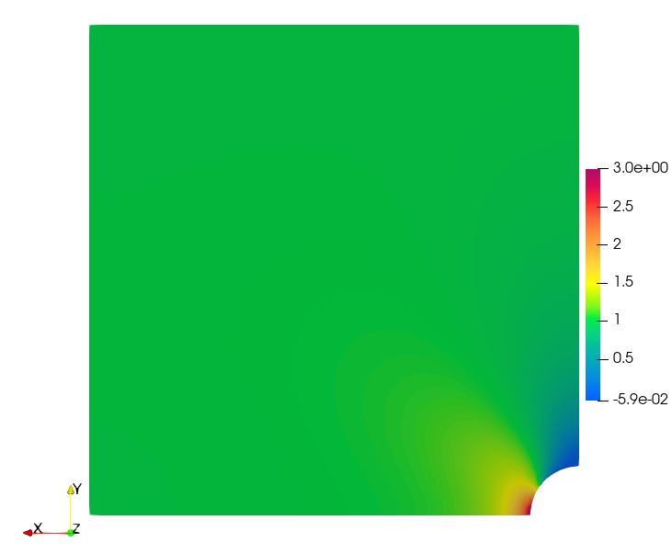
Linear ElastoStatics (ES)
Y
T_{S} = 1.0
Y
Governing Equation
$div σ+f=0$
Constitutive Laws
𝝈 = ℂ $:$ $ε^{E}$
Definition of Strains
$ε^{E}= \frac{1}{2}\left(∇u+{\left(∇u\right)}^{T}\right)$
The Kirsch Problem (Kulesh,2001)
Initial Condition
$u\left((x,y),0\right)=0$
Boundary Condition
$T_{s}\left((x,1.0),t\right)=\left(0.0,1.0\right)$
$u\left((0.0,y),0\right) =\left(0.0,free\right)$
$u\left((x,0.0),0\right) =(free,0.0)$
L = 1.0
R = 0.1
X
X
Plot of $σ_{yy}$ vs $Y$ length

Slide 5
Linear ElastoDynamics (ED)
Governing Equation
$div σ+f=ρ \ddot{u }$
Constitutive Laws
𝝈 = ℂ $:$ $ε^{E}$
Definition of Strains
$ε^{E}= \frac{1}{2}\left(∇u+{\left(∇u\right)}^{T}\right)$
1D-Rod Wave Propagation (Eran,2007)
Initial Condition
$u\left((x,y),0\right)=0$
Boundary Condition:
$T_{s}\left((x,L),t\right)=\left(p,0.0\right)$
$u\left((0.0,y),0\right)=(0.0,free)$
Plot of $σ/ρ$ vs $x/L$ at time $t=0.6s$ over the length

Slide 6
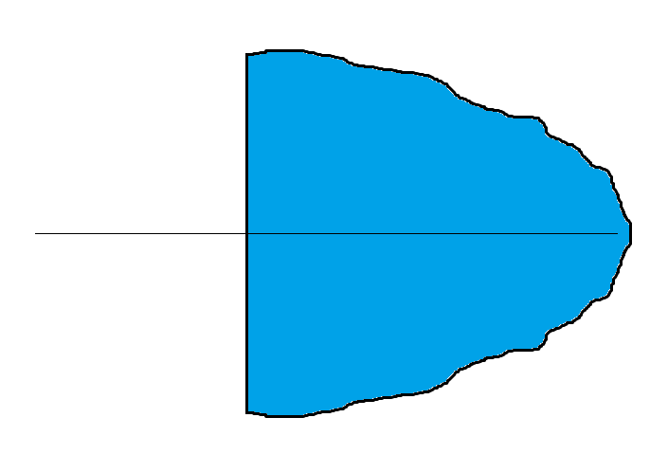
Heat Conduction
Governing Equation
$ρ C_{v} \dot{θ} =−div q$
Fourier Law
$q= −k ∇θ$
1st and 2nd Danilovskaya Problem (Nickel-Sackman, 1968)
Initial Condition Boundary Condition
$θ\left(x,0\right)=0 \left(a\right) θ\left(0,t\right)=\left\{\begin{aligned}0 \\ 1 \end{aligned} \begin{matrix}t<0 \\ 0≤t\end{matrix} \right.$
$\left(b\right) q\left(0,t\right)∙n =H\left(θ−1\right)$
$$\left(a\right)$$
$$\left(b\right)$$
$$BC$$
$$x=0$$
$$x=∞$$
Plot of $θ$(K) vs $t(s)$ at $x=1$

Slide 7
Thermo-ElastoDynamics (T-ED)
$$Analytical Solution$$
$δ$ = 0.00, h = 5.0
$$FEniCS FEM Solution$$
$δ$ = 0.36, h = 5.0
Definition of Strains
$ε= \frac{1}{2}\left(∇u+{\left(∇u\right)}^{T}\right)$
${ ε}^{T}=α \left(θ−θ_{Ref}\right)$
$ε^{E}= \left(ε−ε^{T}\right)$
Governing Equation
$div σ \text{= }ρ \ddot{u } ρ C_{v} \dot{θ} =−div q− {δ θ}_{Ref} β:\dot{ε}$
Constitutive Laws
$\text{σ}\text{ = }\text{ℂ} :\text{(} ε −ε^{T}) q= −k ∇θ$
Fully Coupled Second Danilovskaya Problem (Sternberg,1958)
Initial Condition: Boundary Condition:
$u\left(x,0\right)=0 σ_{xx}\left(0,t\right)=0$
$θ\left(x,0\right)=0 q\left(0,t\right)∙n =h\left(θ−1\right)$
$δ$ = 1.00, h = 5.0
$δ$ = 0.00, h = 0.5
$δ$ = 0.36, h = 0.5
$δ$ = 1.00, h = 0.5
$$q(0,t)$$
$$x=0$$
$$x=∞$$
Plot of u(mm) and $θ$(K) vs $t(s)$ at $x=1.0$

Slide 8
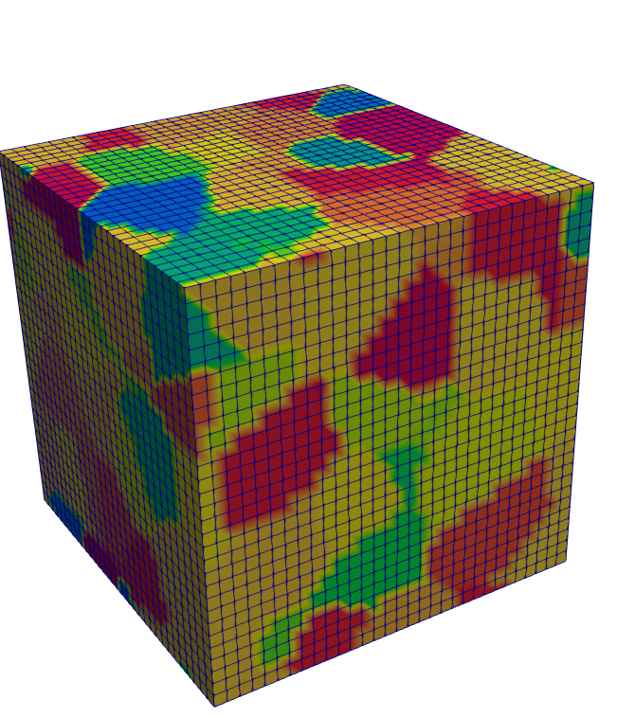
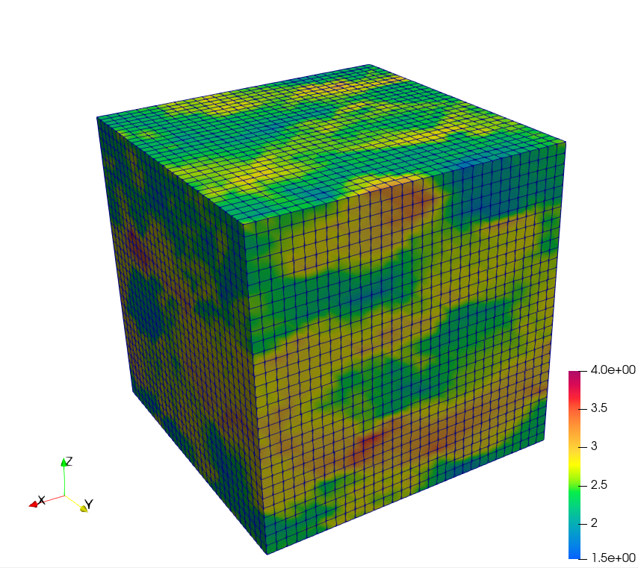
Heterogeneous Elasticity
EBSD Image of Microstructure
Euler Angle
Representation
Stress Field
Calculation
Homogenization Problem
(EVP FFT, Lebonsohn,2012)
Governing Equation
$div σ+f=0$
Constitutive Laws:
$\text{σ}\text{ = }𝕮\text{(}\text{x}\text{,}\text{y}\text{,}\text{z}\text{)} : ε^{E}$
Boundary Condition:
$\dot{ε}$ = $\left[ \begin{matrix}1.0 & 0.0 & 0.0 \\ 0.0 & 0.0 & 0.0 \\ 0.0 & 0.0 & 0.0\end{matrix} \right]$
Plot of $σ$(Mpa) and $ε (mm/mm)$ vs $center to centerX (mm)$

Slide 9
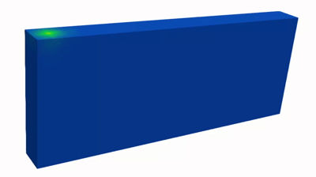
Application Problem : FEM-AM
Transient Displacement Contour over complete domain
Transient Temperature Contour over complete domain
Source: MVU Research Group LMS

Slide 10
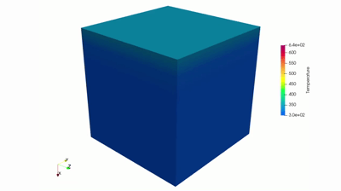
Solution to Application Problem
Plot of $θ$(K) vs $t(s)$ at $Load Surface$
Plot of $σ$(Mpa) and $ε (mm/mm)$ vs $t(s)$ at $body center$

Slide 11
Summary and Perspectives
We have developed a Thermo-Elastodynamic numerical model for anisotropic polycrystalline materials to study solid state thermal cyclic response during metal AM.
Future Perspectives for PhD Research:
Addition of VOCE Hardening Law
Addition of Phenomenological Plasticity Models
Addition of Phase Transformation Models
Addition of Crystal Plasticity Models
Create a Dislocation Dynamics Model for this simulation

Slide 12
End of Presentation

