Slide 1
Conventional and New Models for Simulation of Dynamic Yielding
Peter The Great St. Petersburg Polytechnic University
Scientific advisor: Dr. E. A. Podolskaya
Associate Professor at SPbPU
Work advisor: Dr. V. A. Bratov
Scientific researcher at SPbPU
Prepared by: Karan Gupta

Slide 2
Research Motivation
To investigate the dynamic deformation of materials.
To understand the mechanisms leading to plastic deformation of materials undergoing high-rate loading as this will open new prospects for development of new materials with desired resistance to dynamic loading.
To get the best conventional model that can predict the material behaviour during deformation and its profile evolution.

Slide 3
Problem Statement
During the simulation of dynamic deformation through conventional models, the results are not up to mark and they did not predict the physics of the process, once compare with experimental data.
In this work, simulations of previous models has been performed using commercial FEM software like (Abaqus, Ansys) and then compared with laboratory performed experimental data.
After accounting the drawbacks and there significant error, the new model is implemented to Abaqus software via the user material subroutine (VUMAT) with all the necessary parameters and the physics behind. So, as to get the best solution.

Slide 4
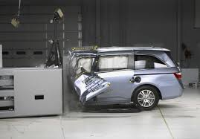
Introduction
The response of a material to high-strain-rate loading is important as it posses the innumerable applications for materials in dynamic and real world environments, such as high-rate forming, ballistics, and impact on vehicle structures.
The rod-on-rigid-anvil impact experiment performed by Taylor in 1948 remains a popular method of investigating the mechanical response of a material to dynamic loading. Taylor's test is a method to evaluate dynamic characteristics of a material deformation.
Figure (1) Impact Test

Slide 5
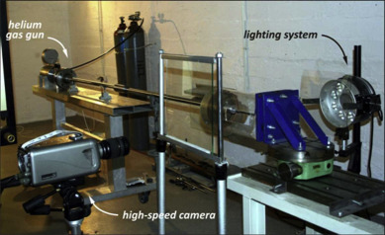
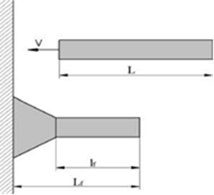
Experimental Taylor Impact Test
Figure (2) Taylor Test
Velocity (m/s) | Initial diameter, $d_{0}$ (mm) | Initial length, $l_{0}(mm)$ | Final diameter, $d_{f}(mm)$ | Final length, $l_{f}(mm)$
83 | 19.1 | 75.1 | 23.6 | 70.3
205 | 18.9 | 75.0 | 36.6 | 54.5
Experimental Data [D. Eakins and N.N. Thadhani]

Slide 6
Conventional model and it’s parameter
This approach is based on "quasistatic" and cannot be used for prediction of high-rate deformation and does not take dynamic effects.
It is widely used model to describe dynamic deformation, additional velocity and temperature dependences are introduced.
It is again based on high strain and temperature but provide good results for low velocity.
This model is implemented in the same manner as Johnson-Cook model, but it is based on dislocation mechanics but results are not good.
Conventional model Parameter table (D. Eakins and N.N. Thadhani)

Slide 7
Conventional Model Result Comparison
S.No | Initial Dimension |  | Experimental Data |  | Von-Mises |  | Johnson-Cook |  | Steinberg-Guinan |  | Zerilli-Armstrong
 | Length (L) | Diameter(D) | L | D | L | D | L | D | L | D | L | D
1- | 76.2 (mm) | 19.05 (mm) | 71.4 (-4.8) mm | 23.65 (+4.6) mm | 69.5 (-6.7) | 22 (+3.4) | 71.1 (-5.1) | 21.3 (+3.0) | 70.4 (-5.78) | 22.70 (+3.49) | 69.3 (-6.9) | 24.85(+5.8)
Error (%) | - | - | - | - | 28.35 | 24.05 | 6.80 | 33.11 | 17.0 | 22.44 | 30.43 | 22.41
Table: Rod (Sample) Dimension table

Slide 8
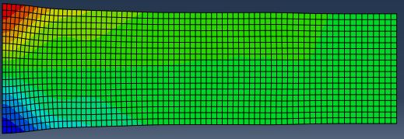
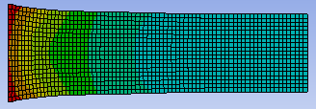
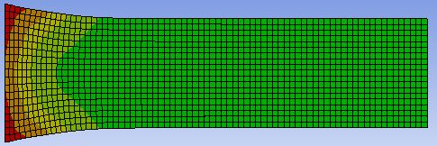
FEA: Simulation Deformed Profile
Figure 3: von Mises Deformed Profile
Figure 5: Johnson-Cook Deformed Profile
Figure 9 : Zerilli-Armstrong Deformed Profile
Figure 4: von Mises Profile Graph with deformation
Figure 6: Johnson-Cook Profile Graph with deformation
Figure 8: Steinberg-Guinan Profile Graph with deformation
Figure 10: Zerilli-Armstrong Profile Graph with deformation

Slide 9
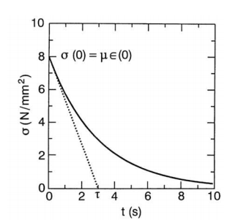
New Model
In a new model, viscoelastic response is established based on Maxwell rheological model (Zener model).
The developed mathematical formulation is implemented in ABAQUS CAE as a user material subroutine (VUMAT).
(Mathematical Description)
For a single Maxwell element representation, the stress-strain relation can be expressed as
Under constant strain, the homogenous solution for equation:
with this IC, constant C is calculated. i.e. t = 0, only spring deforms.
As = 0, leads to particular solution for equation:
(1) Here, is the relaxation time
(2)
(3)
Stress- relaxation (Fig. 11)
Here, the relaxation function is defined as
(4)
Indicates the viscoelastic characteristics of the material.

Slide 10
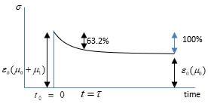
The overall stress acting on the Standard Linear model (Zener) is expressed as
and moduli spring components of the spring element
Relaxation function of Zener model is:
For incremental strain of the material and at initial response commences at time x, the Cauchy stress is expressed as:
Above equation can be formulated in Stress format and is the ratio of to
(5)
(6)
Zener Model (Fig. 12)
(7)
Since, and is a constant and the sum of all the responses for strain over the time t :
(8)
Stress- relaxation (Fig. 13)
(8)
(9)
(10)
Here, is the quasi-static stress , and defines the internal stresses in the element.

Slide 11
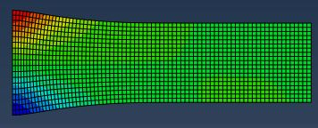
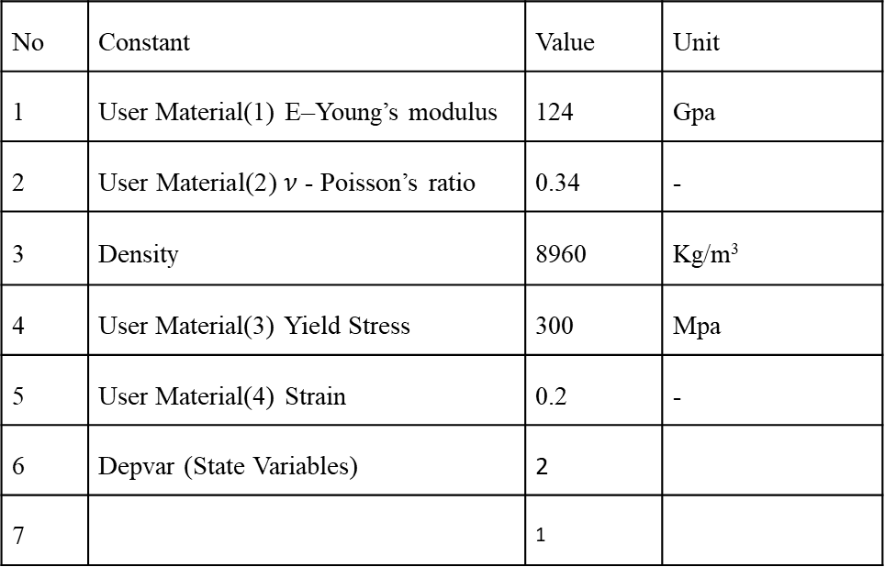
Implementation in FEA (VUMAT): Simulation Deformed Profile
No | Constant | Value | Unit
1 | User Material(1) E–Young’s modulus | 124 | Gpa
2 | $\text{User} \text{Material}\text{(2)} ν$ - Poisson’s ratio | 0.34 | -
3 | Density | 8960 | Kg/m³
4 | User Material(3) Yield Stress | 300 | Mpa
5 | User Material(4) Strain | 0.2 | -
6 | Depvar (State Variables) | 2
7 |  | 1
Simulation Deformed Profile (fig.14)
User Material Parameter table
Figure 15: VUMAT Profile Graph with deformation

Slide 12
FINAL DEFORMED SAMPLE RESULTS COMPARISON
Initial Dimensions | Experimental Results | Deformed Profile Results |  | Error(%)
von Mises Approach
Length (mm) 76.2 | 71.4 (-4.8) | 69.5 (-6.7) |  | 28.35
Diameter(mm) 19.05 | 23.55 (+4.5) | 22.65 (+3.4) |  | 24.05
Johnson-Cook Approach
Length (mm) 76.2 | 71.4 (-4.8) | 71.05 (-5.15) |  | 6.80
Diameter(mm) 19.05 | 23.55 (+4.5) | 22.06 (+3.01) |  | 33.11
Zerilli-Armstrong
Length (mm) 76.2 | 71.4 (-4.8) | 69.3 (-6.90) |  | 30.43
Diameter(mm) 19.05 | 23.55 (+4.5) | 24.85 (+5.8) |  | 22.41
Steinberg-Guinan
Length (mm) 76.2 | 71.4 (-4.8) | 70.42(-5.78) |  | 17.00
Diameter(mm) 19.05 | 23.55 (+4.5) | 22.70(+3.49) |  | 22.44
New Model (VUMAT)
Length (mm) 76.2 | 71.4 (-4.8) |  | 71.2(-5.0) | 4.00
Diameter(mm) 19.05 | 23.55 (+4.5) |  | 24.71(+5.66) | 20.49
Table: Final Rod (Sample) result table

Slide 13
Comparison of the experimental and simulated profile evaluation
Figure 16: Profile Graph with deformation
Figure 17: Profile Graph with deformation
Figure 18: Profile Graph with deformation
Figure 19: Profile Graph with deformation

Slide 14
Comparison of the experimental and simulated profile evaluation
Figure 20: Profile Graph with deformation

Slide 15
Conclusion
As we can see conventional models were giving a close lateral displacement at contact surface but the character of displacement changes when there is no plastic deformation zone.
After comparison all the conventional and new model with experimental data, results shows implemented VUMAT is providing good predictability of shape and size of specimen and stick to the physics of the process.
More modification and generalization in applied VUMAT is possible by taking into account more Maxwell elements. So, as to get exact physics of problem.

Slide 16
Thank You

