Slide 1
St. Petersburg State Polytechnical University
TU Kaiserslautern
Obtaining and investigation of the mechanical properties of pellets
Kim Vitaliy
Yashin Aleksey

Slide 2
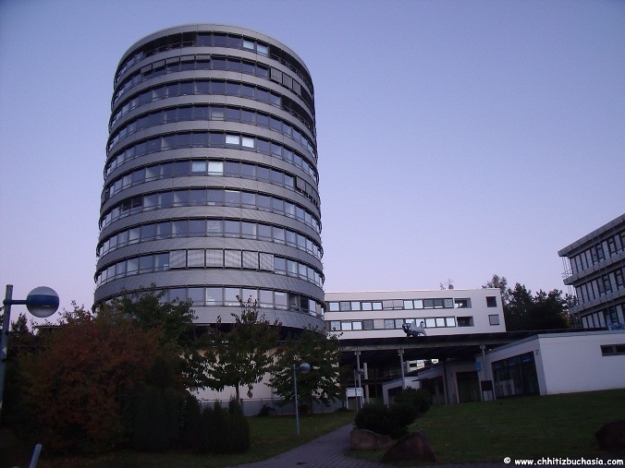
About our internship

Slide 3
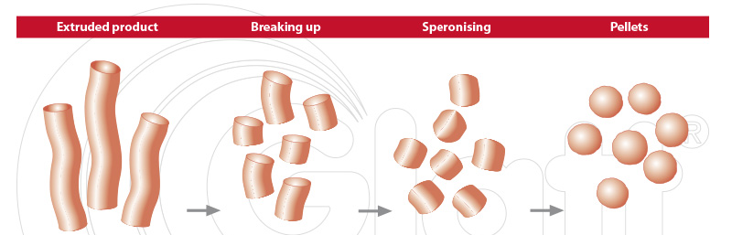
Introduction
Agglomeration of extrusion and spheronization is one of the most known methods of production of the pellets. The process consists of four process stages:
Granulation
Extrusion
Spheronisation
Drying

Slide 4
Granulation
The first step of an extrusion - spheronisation cycle consists of the preparation of the plastic mass. Different types of granulators are used to perform the mixing of the powder blend and the granulation liquid.
During the granulation step the evaporation of the fluid phase should be restricted to a minimum. This could especially be a problem with the high shear mixers as they introduce a large amount of energy into the mass which is partly transformed into heat.

Slide 5
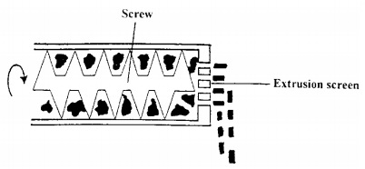
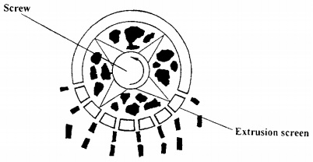
Extrusion
A.
B.
Fig. 1. Schematic view of a screw extruder. (A) Axial type, (B) radial type.

Slide 6
Spheronisation
Fig. 6. Pellet-forming mechanism: I - cylinder; II - rope; III - dumb bell;
IV - sphere with a cavity outside; V, sphere.

Slide 7
Drying
The fourth and final step of the process is the drying of the pellets. The pellets can be dried at room temperature or at elevated temperature in a fluidized bed or in an oven. Bataille in 1993 reported the use of a microwave oven as the final phase in the production process of pellets.

Slide 8
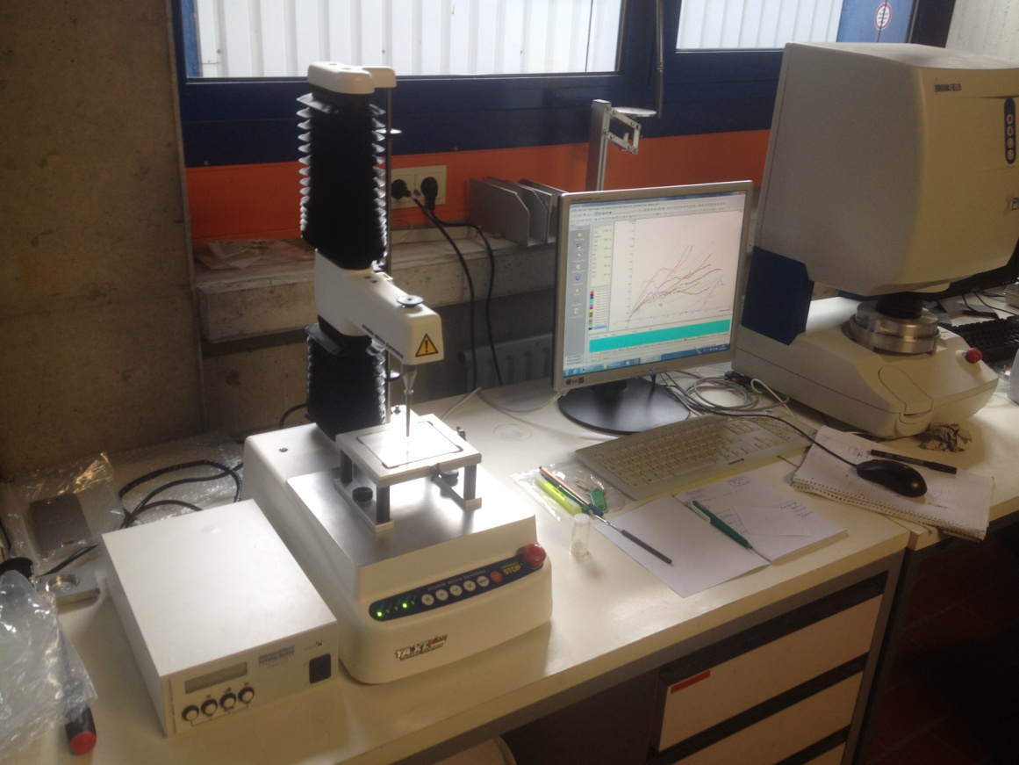
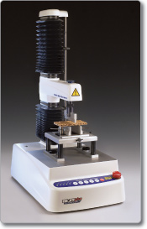
Experiment
Laboratory of powder materials
Texture analysis

Slide 9
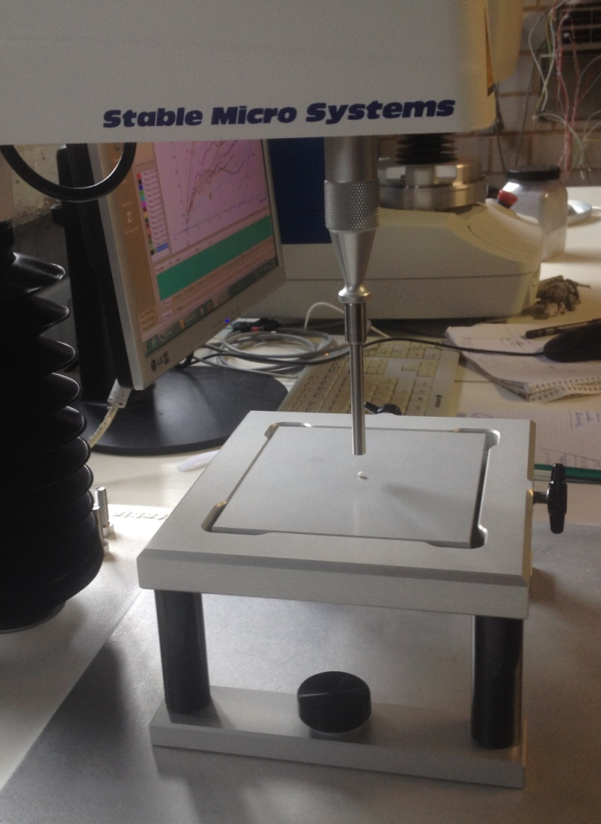
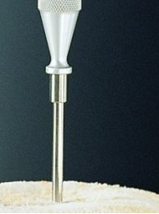
Experiment
Cylindrical probe of stainless steel
Pellet
Table

Slide 10
Experiment
A.
B.
A. – Pellet before test; B. – Pellet after test.
Whole batch after uniaxial compression experiments

Slide 11
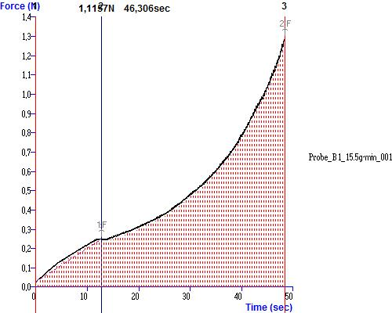
Experiment
Plot built by Exponent software
N p | D, mm | D, m | M, g | M, kg | V, m3 | ρ, kg/m3 | W1, N*mm | W1, J | Wm1, J/kg | W2, N*mm | W2, J | Wm2, J/kg
1 | 3,2 | 0,0032 | 0,026 | 2,64E-05 | 1,716E-08 | 1538,705 | 0,565 | 0,0005653 | 21,41348 | 1,936 | 0,0019356 | 73,317317
2 | 3,397 | 0,0034 | 0,026 | 2,59E-05 | 2,053E-08 | 1261,8697 | 0,797 | 0,0007972 | 30,77981 | 1,115 | 0,0011148 | 43,041719
3 | 2,944 | 0,00294 | 0,021 | 2,12E-05 | 1,336E-08 | 1586,806 | 0,477 | 0,0004773 | 22,51282 | 1,403 | 0,0014031 | 66,182352
4 | 2,837 | 0,00284 | 0,016 | 1,64E-05 | 1,196E-08 | 1371,7255 | 0,443 | 0,0004429 | 27,00636 | 1,457 | 0,0014575 | 88,871046
A data table obtained by analyzing the plot

Slide 12
Experiment
Energy divided by mass distribution
Function describing this distribution

Slide 13
Work plan:
Simulation of spheronization process in EDEM Software
Deformation of one pellet simulation by finite element method

