Slide 1
Generalized problem of thermoelasticity GNIII
Student:
Е. S. Kosyanenko
Saint-Petersburg 2014

Slide 2
Introduction
, h – heat flux, - thermal conductivity, - temperature.
LS theory: was obtained hyperbolic equation of extending the heat, based on the new law of heat conduction:
GL theory is characterized in that heat flux vector in a thermoelastic body h is depends on the rate of change of the absolute temperature θ and temperature gradient:
GN theory combines the properties of both classical thermoelastisity and non-dissipative thermoelasticity. It was formulated in 3 different versions of the thermodynamic: GNI, GNII, GNIII.
GNIII is characterized by that the heat flux vector is linearly depends on the temperature gradient and gradient of the thermacy:

Slide 3
Complete system of relations of GNIII-theory
Λ – thermal conductivity rate , ϑ – thermacy, ρ – density of medium, u – displacement vector, ψ – density of Helmholtz free energy(per unit volume), s – entropy density, ξ – internal entropy production (ξ≥0), σ – heat transfer coefficient, θ_{env} – environment temperature.

Slide 4
Linear coupled equations of motion and heat conduction

Slide 5
Solution
, λ – wave vector

Slide 6
Results of calculations

Slide 7
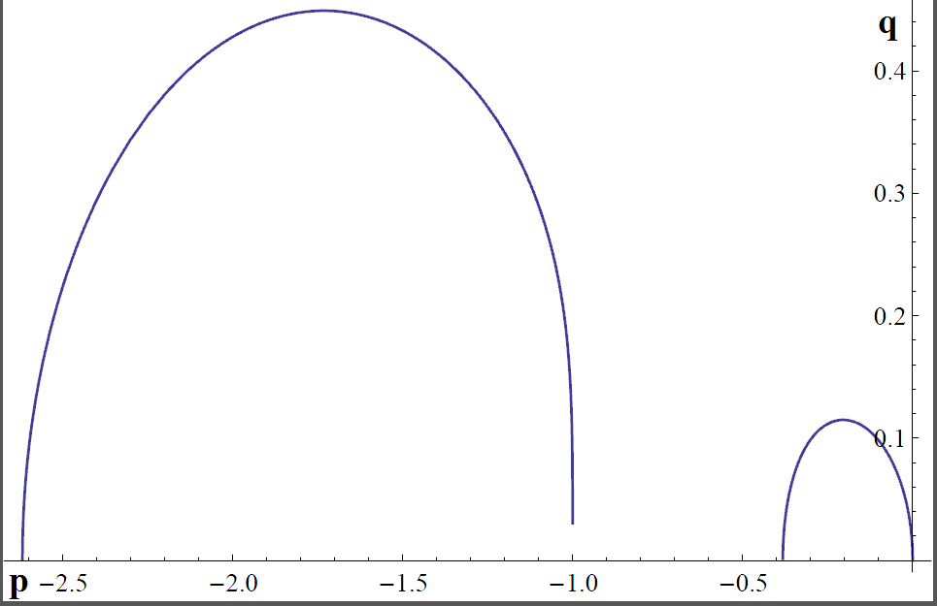
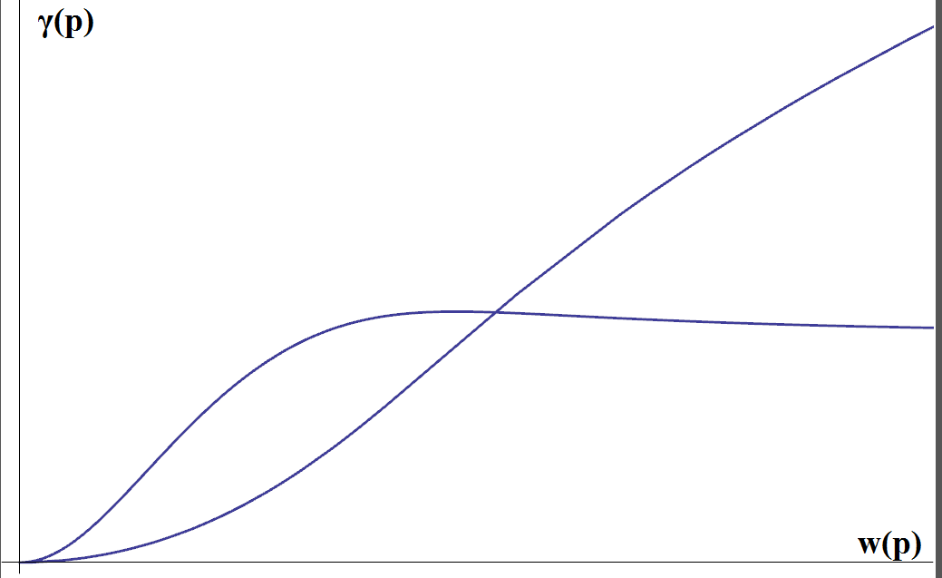
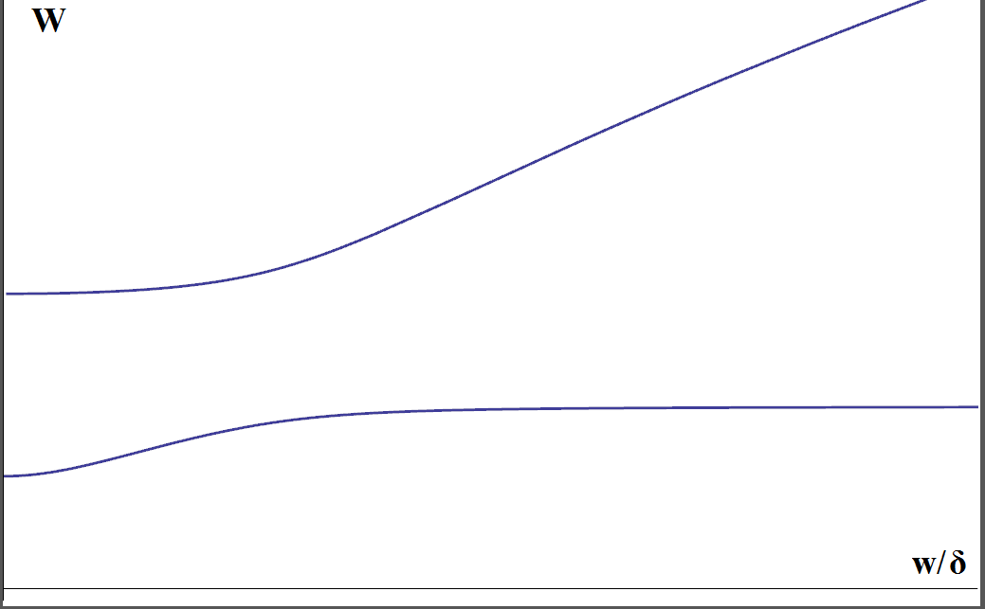
Plots
Pic. 1. Plot q(p)
Pic. 2. Plot γ(w)
Pic. 3. Plot w(w/δ)

Slide 8
Conclusion 1. Studying GNIII-theory. 2. Formulation of the problem. 3. Dimensionless of the equations. 4. Parameterization of the system of equations. 5. Results of calculation is close system of equations. 6. Obtaining plots.

Slide 9
Thank you for attention

