Slide 1
Numerical Simulation of Seismic Waves and Mitigating the Effects by Seismic Barriers
Umut Polat
MSc. Mechanics and Mathematical Modeling
Higher School of Theoretical Mechanics
Peter the Great St. Petersburg Polytechnic University
Scientific supervisor: Assoc. Prof. Dr. Vladimir A. Bratov

Slide 2
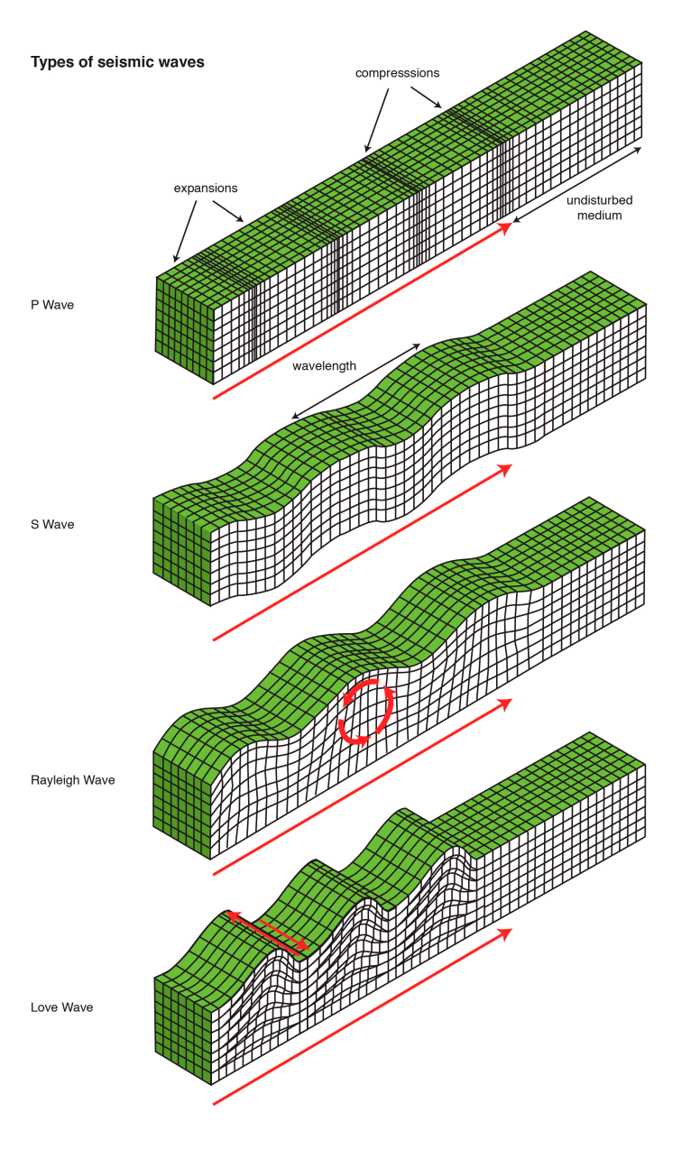
1. Problem Statement
This study focuses on vibration energy isolation by implementing vertical seismic barriers. The aim of this study is to determine an optimal seismic barrier properties that provide the most effective protective zone behind the seismic barrier to defend the structures from the harmful effects of surface waves in the course of an earthquake.
During the earthquake, four main seismic wave types can be observed by utilizing a seismograph: Body waves such as Longitudinal (P-wave) and Transverse (S-wave) waves or surface waves that occur after the body waves in seismograph; Rayleigh and Love waves.
Figure 1. Types of Seismic waves [Shaw, Rod; McMahon,
Glenda; Davey, Kay (2018): Types of seismic waves. Loughborough University. Figure. https://doi.org/10.17028/rd.lboro.7309127.v1]

Slide 3
After Longitudinal and Transverse waves arrival (P and S waves), surface waves are initiated due to the interaction of these waves.
Depending on the medium (Layered medium may cause Love waves if several conditions are met.) Rayleigh or Love waves or their combinations can be observed.
Figure 2. Seismograph recording of an Earthquake in UK [https://sites.google.com/site/haiticholeraepidemic2010/2010-earthquake/meauring-earthquakes]

Slide 4
The first wave that is spotted in the seismograph is “Longitudinal wave” (Primary wave) due to it’s high velocity as it propagates in a medium. This wave can propagate in liquids, gases and solids unlike the other types of waves. As it propagates, the elements of the medium move as push and pull movement (worm-like motion).
Figure 2. Animation of Longitudinal wave (P-wave) [https://web.ics.purdue.edu/~braile/edumod/waves/WaveDemo.htm]
The Longitudinal wave speed in an elastic medium can be calculated by equation (1).
(1)
Since the medium is elastic, Lame constants (λ and μ) can be utilized. ρ is denoted as the material density (kg/m³).

Slide 5
After Longitudinal wave, slower “Transverse wave (S-wave)” can be observed in the seismograph as a second wave. The propagation motion is transversal. Thence, while it is moving, particles move up and down along with the direction of propagation.
It has higher amplitude compared to Longitudinal wave (P-wave). The velocity of the Transverse wave can be found as using Lame constants:
(2)
Figure 3. Animation of Transverse wave (S-wave) [https://web.ics.purdue.edu/~braile/edumod/waves/WaveDemo.htm]

Slide 6
First found by Lord Rayleigh in 1885, Rayleigh waves originate as a result of interaction between Longitudinal and Transverse waves.
Rayleigh wave travels along with the upper layer of the Earth crust, thus it contains localized, high vibration energy at the surface and the amplitude of vibration decreases with depth.
The Rayleigh wave speed depends on the transverse wave speed and the Poisson ratio (υ).
(3)
This approximation was found by A. Viktorov in 1967.
Figure 4. Animation of Rayleigh wave [https://web.ics.purdue.edu/~braile/edumod/waves/WaveDemo.htm]

Slide 7
Love waves propagate on the interface between elastic half-plane and contacting layer as long as the following condition is satisfied:
Tractions at the surface should be zero. ( where t is surface tractions, σ^{T} is Cauchy stress tensor and n is the normal vector to the surface)
The contact layers transverse bulk wave speed should be smaller than the half-planes transverse bulk wave speed. ( where C* represents speed of transverse waves.
While Love wave propagates, particles move perpendicular to the direction of propagation.
Figure 5. Animation of Love wave propagation [https://web.ics.purdue.edu/~braile/edumod/waves/WaveDemo.htm]

Slide 8
Mathematical Expression of Rayleigh Wave Propagation
Assuming the wave propagation medium is elastic, isotropic homogenous media, equation of motion can be described by Navier-Clapeyron theorem [François, D., Pineau, A., & Zaoui, A. (1998). Mechanical behaviour of materials]:
(4)
Where λ and µ are Lame constants, ρ is material density, f is body forces field and u is displacement vector.
Equation (4) can be rewritten considering P and S waves. Substituting equation (1) and (2) into equation (4), equation of motion in terms of P and S waves can be obtained.
Where displacement vector u can be decompose into vector and scalar potentials by Helmoltz decomposition theorem.
(6)
In which Φ is vector potential and scalar potential K satisfies /.

Slide 9
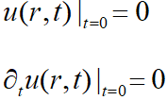
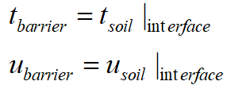
The displacement field in x and y direction thus, can be written for Rayleigh wave propagation in half-space by the equations (7) and (8) respectively.
(7)
(8)
Boundary condition:
On the boundary surface of a half plane Ώ , (considering the isotropic media) it is assumed that there are no tractions. Therefore, equation (9) can be used as a boundary condition.
(9)
Assuming no tractions on the surface: where is the unit normal to the surface, I is the unit diagonal matrix and ε is small strain tensor. ( )
Initial Condition
Since there are no initial stresses in the half plane, initial conditions were taken as stated below:
(10)
(11)
At the interface between soil and seismic barrier ideal mechanical contact was used.
(12)
(13)

Slide 10
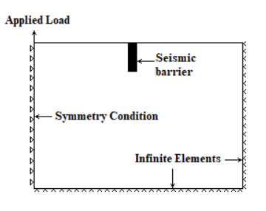
Numerical Simulation
An elastic half-space (70m x 35m) was modelled in finite element modelling software ABAQUS. Explicit Dynamic analysis method was utilized to simulate the wave propagation.
An excitation force was given from the top left corner where the symmetry condition applied.
The harmonic excitation was given according to function , where A is maximum amplitude, f is frequency and t is cumulative time.
Figure 6. Numerical model and boundary conditions in Abaqus
Figure 7. Dimensions of seismic barriers

Slide 11
For the seismic barriers, the table of material properties were chosen as stated below. For soil, dense sand was chosen as a material property.
In order to see the effectiveness of seismic barriers, amplitude reduction rate was calculated as considering the equation below.
where A_{without} represents maximum acceleration amplitude and A_{after} stands for maximum acceleration amplitude after placing seismic barrier or with empty trench depending on the experiment.
Table 1. Material properties of seismic barrier materials [¹https://www.academia.edu/8149496/APPC-Soil_Properties, ²Goris, A. (2006). Bautabellen für Ingenieure: mit Berechnungshinweisen und Beispielen]

Slide 12
Numerical Simulation Results
Placing an empty trench decreased
the maximum acceleration amplitude
up to around 10 m/s². It was observed
that by increasing depth of the empty
trench, more reduction in the amplitude
of the wave can be achieved.
The reduction factor was obtained
up to 91 per cent with 5.5-meters depth empty trench. As it can be monitored from the graph, after 10 meters, the reduction rate of the vibration energy steadily decreased.
Figure 8. Maximum acceleration graph as moving away from the barrier with empty trench
Figure 9. Amplitude reduction factor as moving away from the barrier with empty trench

Slide 13
After planting a seismic barrier with the concrete 20/25 material, maximum acceleration dimished up to 4.6 m/s².
With Concrete material 88 per cent reduction rate was obtained. After 22 meters away from the barrier, the reduction rate was reduced due to attenuation of the wave with distance. The effective protection zone thus was remarked as 22 meters.
Figure 10. Maximum acceleration graph as moving away from the barrier with 20/25 Concrete material
Figure 11. Amplitude reduction factor as moving away from the barrier with 20/25 Concrete material

Slide 14
Applying EPS as a seismic barrier material reduced the maximum amplitude up to 3.4 m/s². Placing the seismic barrier with 5.5 meters depth resulted maximum reduction in the acceleration.
91 per cent of the reduction in the amplitude of acceleration was gained by applying 5.5 meters depth seismic barrier with EPS. The effective protection zone was noted as 22 meters.
Figure 12. Maximum acceleration graph as moving away from the barrier with EPS GeoFoam material
Figure 13. Amplitude reduction factor as moving away from the barrier with EPS GeoFoam material

Slide 15
For the last experiment, a composite which consists of EPS GeoFoam and concrete 20/25 material, was implemented to the seismic barrier. Up to the acceleration of 5.2 m/s² was achieved as similar to the results of EPS.
Applying composite (GeoFoam and concrete 20/25) helped the reduction factor to reach until 89 per cent at the same time provided the longest effective protection zone (around 28 meters) among the other seismic barriers.
Figure 14. Maximum acceleration graph as moving away from the barrier with Composite material
Figure 15. Amplitude reduction factor as moving away from the barrier with Composite material

Slide 16
Results and Discussion
Increasing the barrier depth was proved to be helpful for the sake of vibration isolation for all the barrier properties.
Stiffer material (Concrete 20/25) provided a reduction rate of 88 per cent and 22 meters of protection zone was obtained. Therefore, applying concrete as a seismic barrier material can be helpful to get reasonable reduction and the protection distance.
Empty trenches provided very effective but shallow protection as granting 10 meters of protection zone with 91 per cent amplitude reduction rate. The sudden decrease in the acceleration amplitude after 10 meters was associated with the Rayleigh wave overflowing the empty trench and continuing to propagate.
EPS GeoFoam rendered satisfactory reduction in vibration as 91 per cent. However, effective protection zone was similar to the protection zone which stiffer concrete material contributed as 22 meters.
Applying composite material which is composed of GeoFoam and concrete 20/25 was found out to be the most effective barrier material since it provided longest protection zone and at the same time 89 percent reduction rate in the acceleration rate.
According to this study, the most effective barrier was depicted as Composite material which was made of softer EPS GeoFoam and Concrete material as providing the longest effective protection zone with the upstanding amount of reduction rate.

Slide 17
Thank you for your attention.

